Slide 1

Smart Attendance Management System Using Face Recognition with OpenCV
ITA0502– COMPUTER VISION
Presentation By :
192311062 P.Reddy Renuka
192321117 Oviya M
192421032 Thulasi I
192521429 Maha Swetha
192425355 Yambadi thanushma
192425177 Yarrabolu Navya
Program Director : Dr. Sasi Rekha, Prof/CSE
Faculty:- Mrs. R C Jeni Gracia, AP / CSE

Slide 2


Agenda
Introduction
Literature Review
Problem Statement
Objectives
System Architecture - Overall Design of Project
Modules Introduction
Results and discussion
Implementation
Application
Future Scope
Conclusion
References

Slide 3
Introduction
Smart Attendance Management System Using OpenCV-Based Face Recognition automates the attendance process using computer vision.
It detects and recognizes students' faces through a webcam.
Attendance is recorded automatically with the student's name, date, and time.
The system improves accuracy, saves time, and prevents proxy attendance.
It demonstrates the practical application of OpenCV and Computer Vision in educational institutions.

Slide 4
Literature Review
Author & Year | Paper Title | Method Used | Key Findings | Advantages | Limitations
Chandra et al. (2021) | Automated Attendance System Using Face Recognition | OpenCV + Face Recognition | Automated attendance with improved accuracy and reduced manual effort. | Contactless attendance, saves time, reduces manual errors. | Performance decreases under poor lighting and different face angles.
Ashwin Rao (2022) | Real-Time Face Recognition Based Attendance System | Face Recognition + Computer Vision | Real-time attendance system with reduced proxy attendance. | Real-time identification, reduces proxy attendance, easy to use. | Requires a high-quality camera for better recognition accuracy.
A. Kumar et al. (2023) | Face Recognition Based Smart Attendance Management System | OpenCV + Face Recognition | Reliable real-time face recognition for attendance management. | Fast recognition, automated attendance, reduces human intervention. | Recognition accuracy may decrease when multiple faces are present simultaneously.
Jayaraj Viswanathan et al. (2024) | Smart Attendance System Using OpenCV and Machine Learning | OpenCV + Machine Learning | Improved attendance efficiency with minimal human intervention. | Efficient, automated, reduces workload and improves attendance monitoring. | Performance may be affected by face masks and occlusions.
Divyanshu Bhardwaj et al. (2025) | Cloud-Based Smart Attendance System Using Face Recognition | OpenCV + Flask + Google API | Secure and real-time attendance with cloud integration. | Cloud storage, real-time access, secure attendance records, easy report management. | Requires a stable internet connection for cloud-based features.

Slide 5
Problem Statement
Traditional attendance methods are time-consuming and prone to human errors.
Manual attendance allows proxy attendance and inaccurate record keeping.
Existing face recognition systems may perform poorly under varying lighting conditions and face angles
here is a need for a cost-effective, accurate, and real-time attendance system using OpenCV-based face recognition to automate attendance and improve efficiency.

Slide 6
Objectives
To develop a smart attendance management system using OpenCV-based face recognition.
To detect and recognize students' faces in real time using a webcam.
To automatically record attendance with the student's name, date, and time.
To reduce manual effort, human errors, and proxy attendance.
To improve the accuracy and efficiency of attendance management.

Slide 7
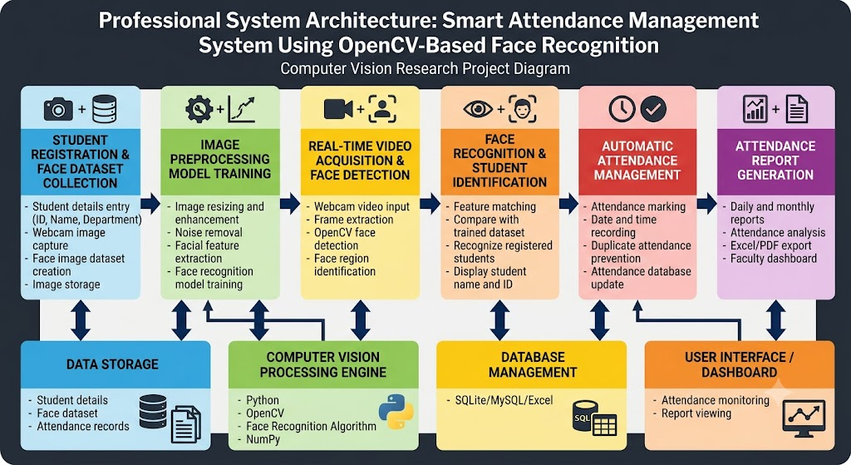
Architecture

Slide 8
Module 1 – Student Registration & Face Dataset Collection
.
This module registers the student's ID, Name and required details and collects multiple face images using a webcam.
OpenCV and Haar Cascade Classifier are used to detect the student's face.
he captured image is converted into grayscale, the detected face is cropped, and 20–50 images are stored with the student's ID.
Algorithm: Register details → Start webcam → Capture image → Grayscale conversion → Haar Cascade face detection → Crop face → Save dataset.
Approach: The collected face dataset is used for training the face recognition model, improving student identification and attendance accuracy.

Slide 9
Module 2 – Image Preprocessing & Face Model Training
This module prepares the collected face images for recognition by applying image preprocessing and model training techniques.
The captured face images are converted into grayscale and resized to maintain a consistent image format.
LBPH (Local Binary Pattern Histogram) algorithm is used to extract facial features and train the face recognition model.
Algorithm: Load dataset → Grayscale conversion → Resize images → Extract LBPH features → Train recognition model → Save trained model.
Approach: The trained LBPH face recognition model learns the facial patterns of registered students and is later used to identify them during real-time attendance.

Slide 10
Module 3 – Real-Time Face Detection
This module detects student faces in real time from live webcam video.
The captured video frames are converted into grayscale for efficient face detection.
Haar Cascade Classifier is used to detect and locate faces in each frame.
Algorithm: Start webcam → Capture frame → Grayscale conversion → Haar Cascade detection → Locate face → Draw bounding box.
Approach: The detected face is extracted and passed to the Face Recognition module for identifying the registered student.

Slide 11
Module 4 – Face Recognition
This module identifies the detected student face by comparing it with the trained face recognition model.
The detected face is processed and its facial features are compared with the stored student dataset.
LBPH Face Recognizer is used to match the detected face with the registered student.
Algorithm: Detect face → Extract face region → Compare with trained model → Calculate confidence → Identify student.
Approach: If a matching face is found within the acceptable confidence level, the Student ID and Name are retrieved for attendance marking.

Slide 12
Module 5 – Automatic Attendance Management
This module automatically records attendance after successful face recognition.
The recognized student's ID, Name, Date and Time are captured and stored.
The system checks for duplicate attendance to avoid multiple entries for the same student.
Algorithm: Recognize student → Verify identity → Check duplicate entry → Record date & time → Mark attendance.
Approach: Attendance is automatically stored in a CSV/Excel file or database, reducing manual work and proxy attendance.

Slide 13
Module 6– Attendance Report Generation
This module generates daily and monthly attendance reports from the recorded attendance data.
The stored attendance records are retrieved from the CSV/Excel file or database.
The system calculates the attendance percentage for each student.
Algorithm: Load attendance data → Filter by date/student → Count Present/Absent → Calculate percentage → Generate report.
Approach: The generated reports provide a clear view of student-wise attendance and attendance percentage for easy monitoring.

Slide 14
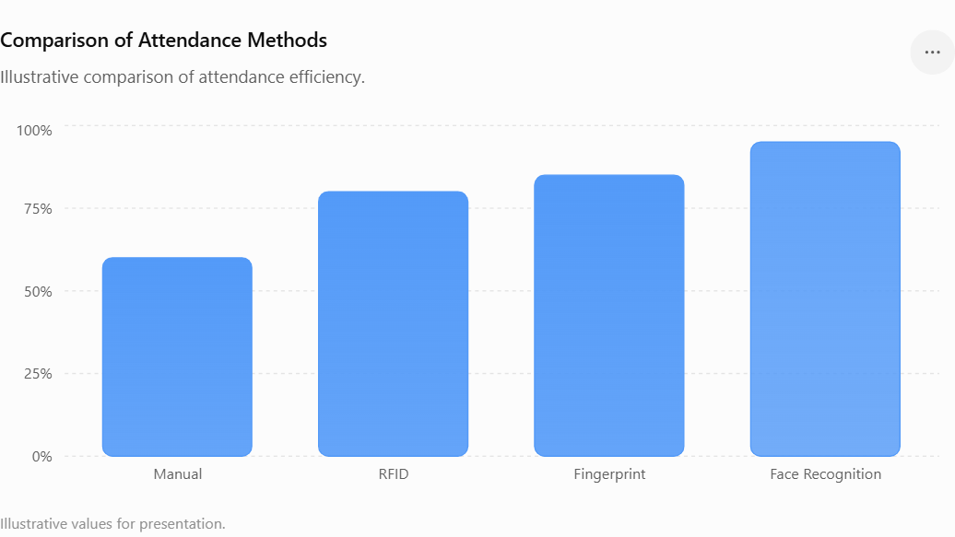
Result and discussions
The proposed Face Recognition Attendance System provides faster and more automated attendance compared with traditional methods.
Manual attendance requires more time and human effort.
RFID and Fingerprint systems reduce manual work but require physical cards or contact-based identification.
Face recognition provides contactless, real-time identification using a webcam.
The proposed system helps reduce proxy attendance, duplicate entries and manual errors.
Values: Manual – 60%, RFID – 80%, Fingerprint – 85%, Face Recognition – 95%

Slide 15

Applications
Educational Institutions – Automates student attendance in schools, colleges and universities.
Corporate Offices – Monitors employee attendance and working hours.
Training Centers – Records attendance of trainees automatically.
Examination Halls – Helps verify student identity and attendance.
Workshops & Seminars – Provides quick and contactless participant attendance.
Organizations – Maintains digital attendance records and reduces manual effort.

Slide 16
Conclusions
The Smart Attendance Management System provides an automated and contactless method for recording attendance.
OpenCV, Haar Cascade and LBPH are used for face detection and recognition.
The system automatically identifies registered students and records ID, name, date and time.
It reduces manual effort, saves time and minimizes proxy attendance.
The generated attendance reports make monitoring and record management easier.
Overall, the proposed system provides a simple, efficient and reliable solution for smart attendance management.

Slide 17
References
Viola, P., & Jones, M. (2001). Rapid Object Detection Using a Boosted Cascade of Simple Features. Proceedings of CVPR, 1, 511–518.
Ahonen, T., Hadid, A., & Pietikäinen, M. (2006). Face Description with Local Binary Patterns: Application to Face Recognition. IEEE Transactions on Pattern Analysis and Machine Intelligence, 28(12), 2037–2041.
Kale, M., Nawale, N., Chandane, S., & Chavhan, A. (2021). Face Detection and Recognition for Automatic Attendance System. International Journal of Recent Advances in Multidisciplinary Topics, 2(4), 104–107.
Beri, N., Srivastava, V., & Malik, N. (2024). Face Recognition Attendance Management System Using LBPH and Haar Cascade. Journal of Trends in Computer Science and Smart Technology, 6(3), 257–273.

Slide 18
THANK YOU

